Slide 1
PARVAM SOFTWARE SOLUTIONS
Internship Project Presentation On
SCHOOL ERP SYSTEM
Presented by
Sinchana A S : 4GH21CS045
Swathi M N : 4GH21CS054
Varshini C : 4GH21EC054
Under The Guidance Of
Murthy P G Sir

Slide 2
TABLE OF CONTENTS
INTRODUCTION
PROBLEM STATEMENT
OBJECTIVES
LIMITATIONS OF PREVIOUS WORK
METHODS AND TOOLS
USER ROLES
SYSTEM ARCHITECTURE
METHADOLOGY
SNAPSHOTS
BENEFITS
CONCLUSION

Slide 3
INTRODUCTION
What Is An ERP? ERP (Enterprise Resource Planning) Is A Software System Used To Manage And Integrate The Core Processes Of An Organization.
What Is A School ERP System? A School ERP Is A Comprehensive Software Platform Designed To Automate And Manage Academic And Administrative Operations In Educational Institutions.
Why Is It Important?
Reduces Manual Work And Paperwork
Ensures Transparency And Accuracy
Centralizes Data For Easy Access
Improves Communication Among Students, Teachers, Parents, And Administration

Slide 4
PROBLEM STATEMENT
Schools face inefficient manual processes for managing student, teacher, and administrative data.
Lack of centralized data storage leads to data redundancy and errors.
Monitoring attendance, performance, and fees is time-consuming and prone to mistakes.
Communication gaps exist between teachers, students, parents, and administration.
Absence of role-based access results in security and privacy concerns.
Existing systems lack real-time reporting and analytics, making informed decision-making difficult.

Slide 5
OBJECTIVES
Develop a comprehensive School ERP system to automate and simplify school management tasks.
Implement role-based access control for Admin, Teachers, and Students to ensure data security and privacy.
Create modules for Student Management, Teacher Management
Enable centralized data management for easy access and maintenance.
Provide real-time monitoring and reporting tools to facilitate data-driven decisions.
Design a user-friendly interface to encourage adoption by all users.

Slide 6
LIMITATIONS OF FUTURE WORK
Resource Constraints Implementation of advanced features like AI and mobile apps may require significant time, budget, and skilled personnel.
Integration Challenges Integrating new modules with existing legacy systems or third-party tools can be complex.
Data Privacy & Security Risks Expanding features and access points might increase vulnerability to data breaches without robust safeguards.
User Adoption Training and adapting to new technologies may face resistance from some users initially.
Scalability Issues Ensuring smooth performance as the user base and data grow requires ongoing optimization.

Slide 7
METHODS AND TOOLS
Backend: Spring Boot (Java Framework)
Frontend: Thymeleaf, HTML, CSS, JavaScript,Bootstrap
Database: MySQL
Version Control: Git & GitHub
Build Tool: Maven
IDE: Eclipse

Slide 8
USER ROLES
Admin
Can Manage Everything In The System.
Adds Or Updates Student And Teacher Details.
Manages Attendance, Timetables, And System Users.
Faculty
Can Take Student Attendance.
Can See Their Own Timetable.
Can View And Manage Student Data (Like Marks, Performance).
3. Student
Can Log In And See Their Own Information.
Can Receive Important Announcements Or Updates.

Slide 9
SYSTEM ARCHITECTURE
Client-Server Model: The system follows a client-server architecture where the frontend (client) interacts with the backend server via HTTP requests.
Three-Tier Architecture:
Presentation Layer: User interface built with Thymeleaf, HTML, CSS, and JavaScript,Bootstrap.
Business Logic Layer: Spring Boot handles core application logic and role-based access.
Data Layer: Database (MySQL) stores all school data securely.
Role-Based Access Control (RBAC): Different user roles (Admin, Teacher, Student) have access only to their authorized modules and functionalities.

Slide 10
METHODOLOGY
Requirement Gathering
Identify user needs and define core modules (admissions, attendance, fees, etc.).
System Design
Design database, UI, and system architecture.
Frontend Development
Build responsive user interfaces using HTML,CSS, JavaScript and Bootstrap
Backend Development
Develop secure APIs, implement business logic, and manage data storage.
Integration
Connect frontend with backend and ensure smooth data flow.
Testing
Perform unit, integration, and user acceptance testing.

Slide 11
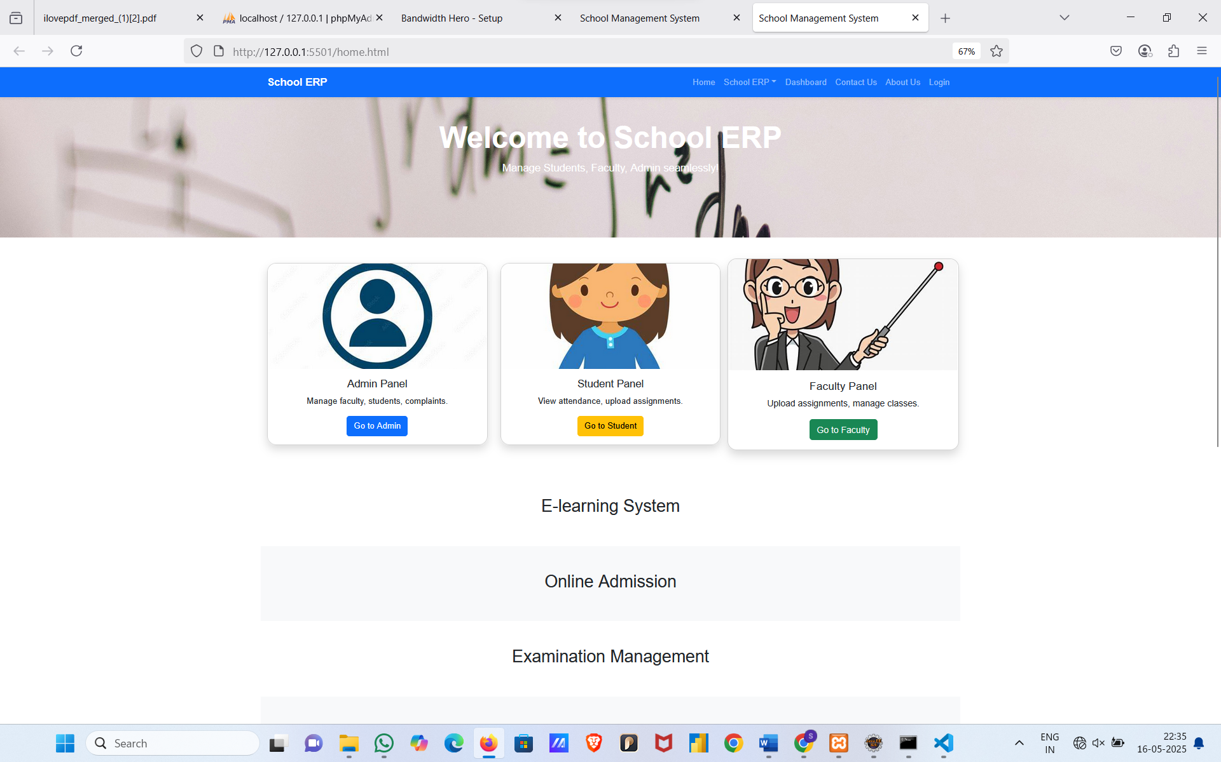
SNAPSHOTS
Home Page

Slide 12
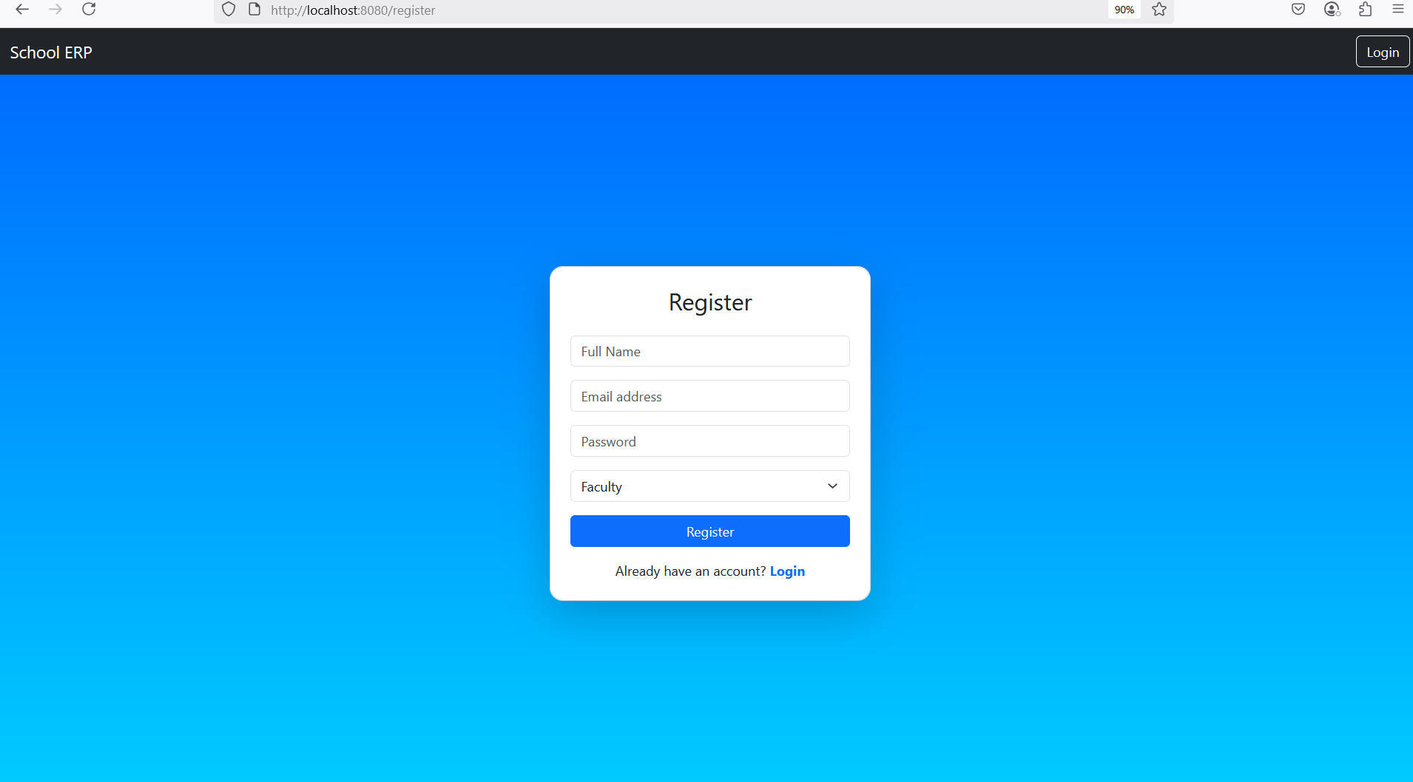
Register Page

Slide 13
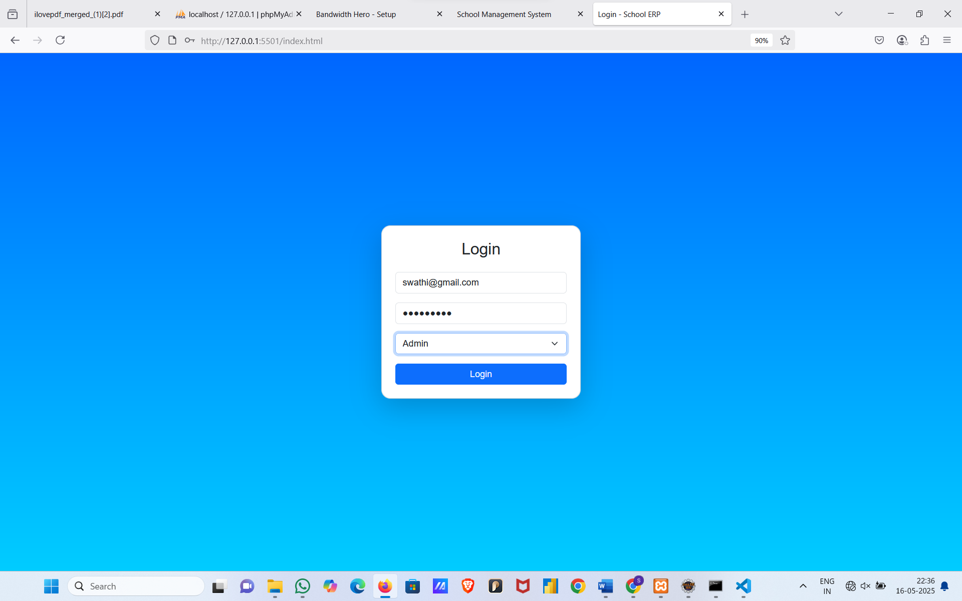
Login Page

Slide 14
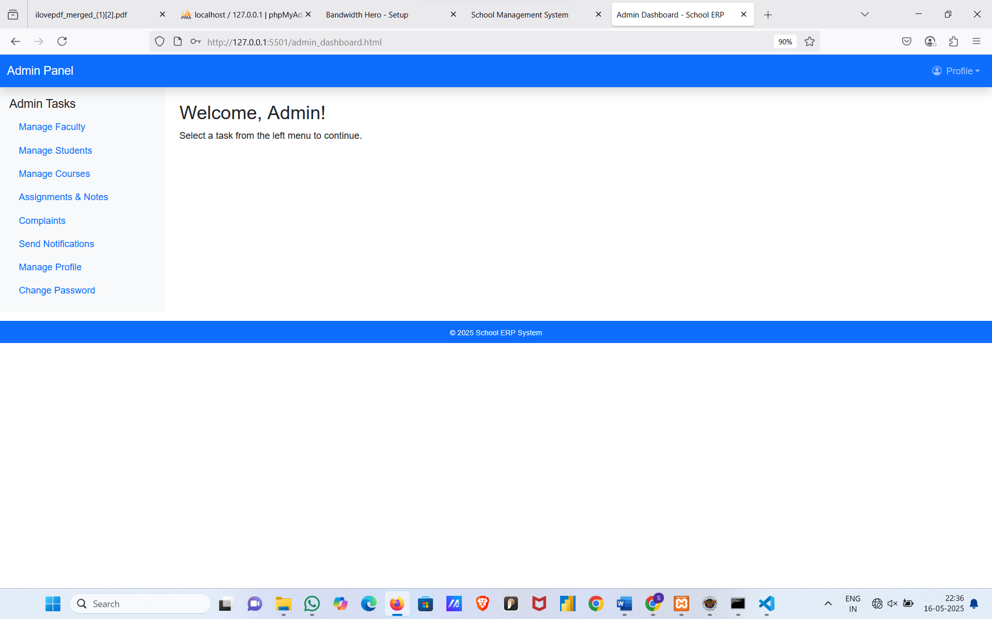
Admin Dashboard Page

Slide 15
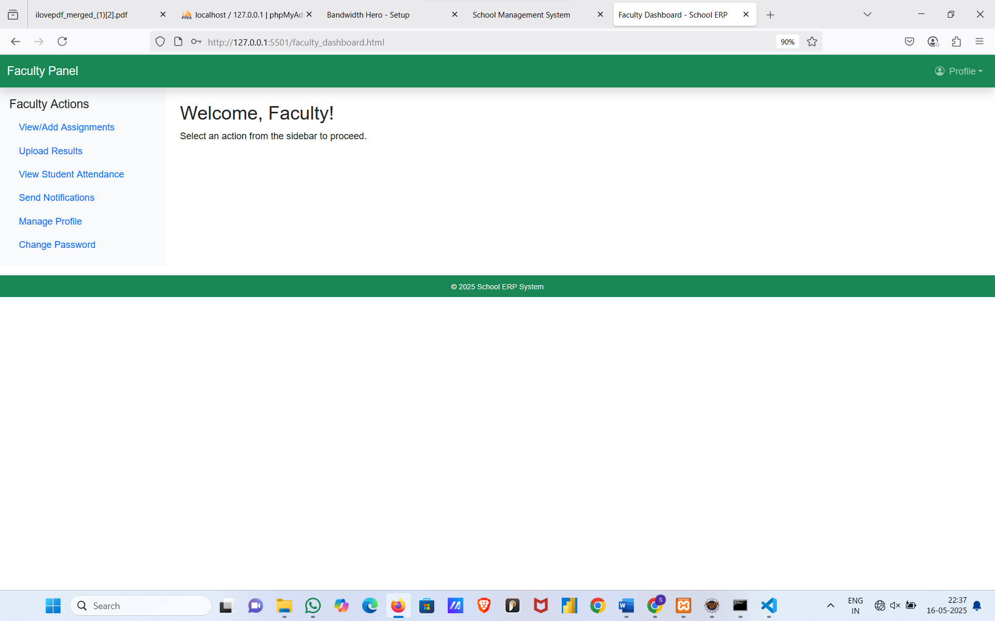
Faculty Dashboard Page

Slide 16
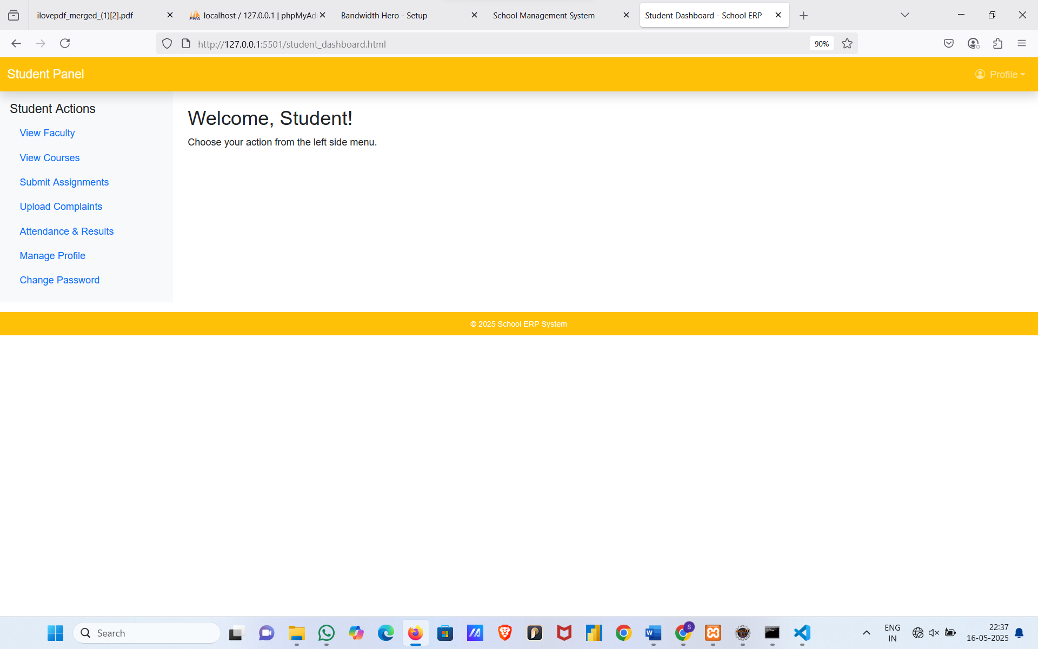
Student Dashboard Page

Slide 17
BENEFITS
Saves Time And Effort By Automating Daily School Tasks.
Reduces Manual Errors And Improves Accuracy.
Improves Communication Between Admin, Teachers, And Students.
Easy Access To Data From Anywhere, Anytime.
Better Management Of Records Like Attendance, Timetable, And Reports.
Supports Digital Transformation Of The School System.

Slide 18
CONCLUSION
The School ERP System Automates And Simplifies School Management Tasks.
Ensures Easy And Secure Access For Admin, Teachers, And Students.
Reduces Manu9al Errors And Saves Valuable Time.
Improves Record Keeping, Attendance Tracking, And Timetable Management.
Helps Schools Move Towards Digital And Paperless Operations.
Can Be Expanded With More Features As Per Future Needs.

Slide 19
THANK YOU

